Slide 1

Rice University FinTech
Project One:
Botley Fool
(Automated Technical Analysis & Trading)
Group 1: Blake Gregory, Maurice Duré, and TJ Azodeh

Slide 2
Hypothesis and Goal
To find the most efficient indicator or group of indicators to implement into our botley fool.
We will test different trading strategies using data fetched with the Alpaca API and trading strategies implemented using Alpha Vantage API
The goal is to pull trading data and results, analyze and then visualize results to show why the trading strategies we are using are the most efficient in the trading bot for the lowest risks with the highest returns based on the data.

Slide 3

Indicators being Analyzed

Slide 4
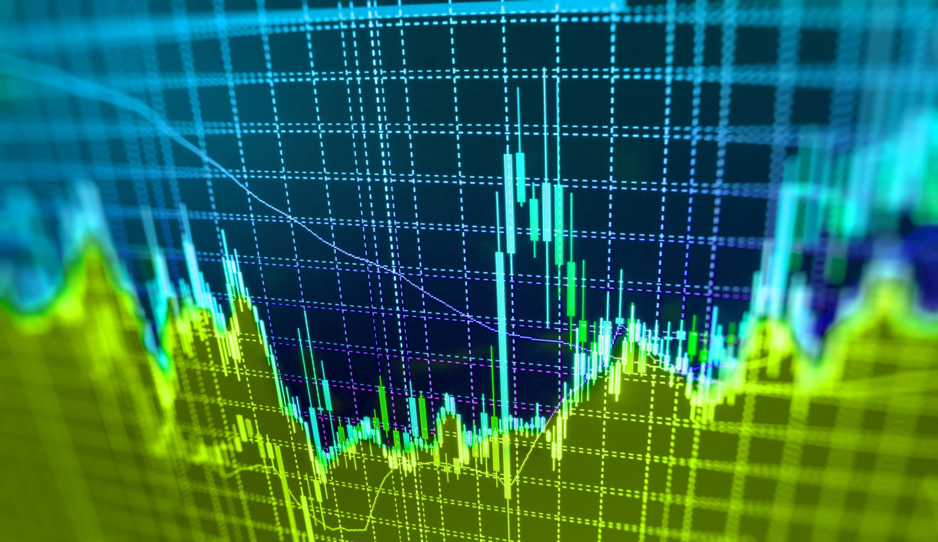
Simple Moving Average

Slide 5
Estimated Moving Average

Slide 6
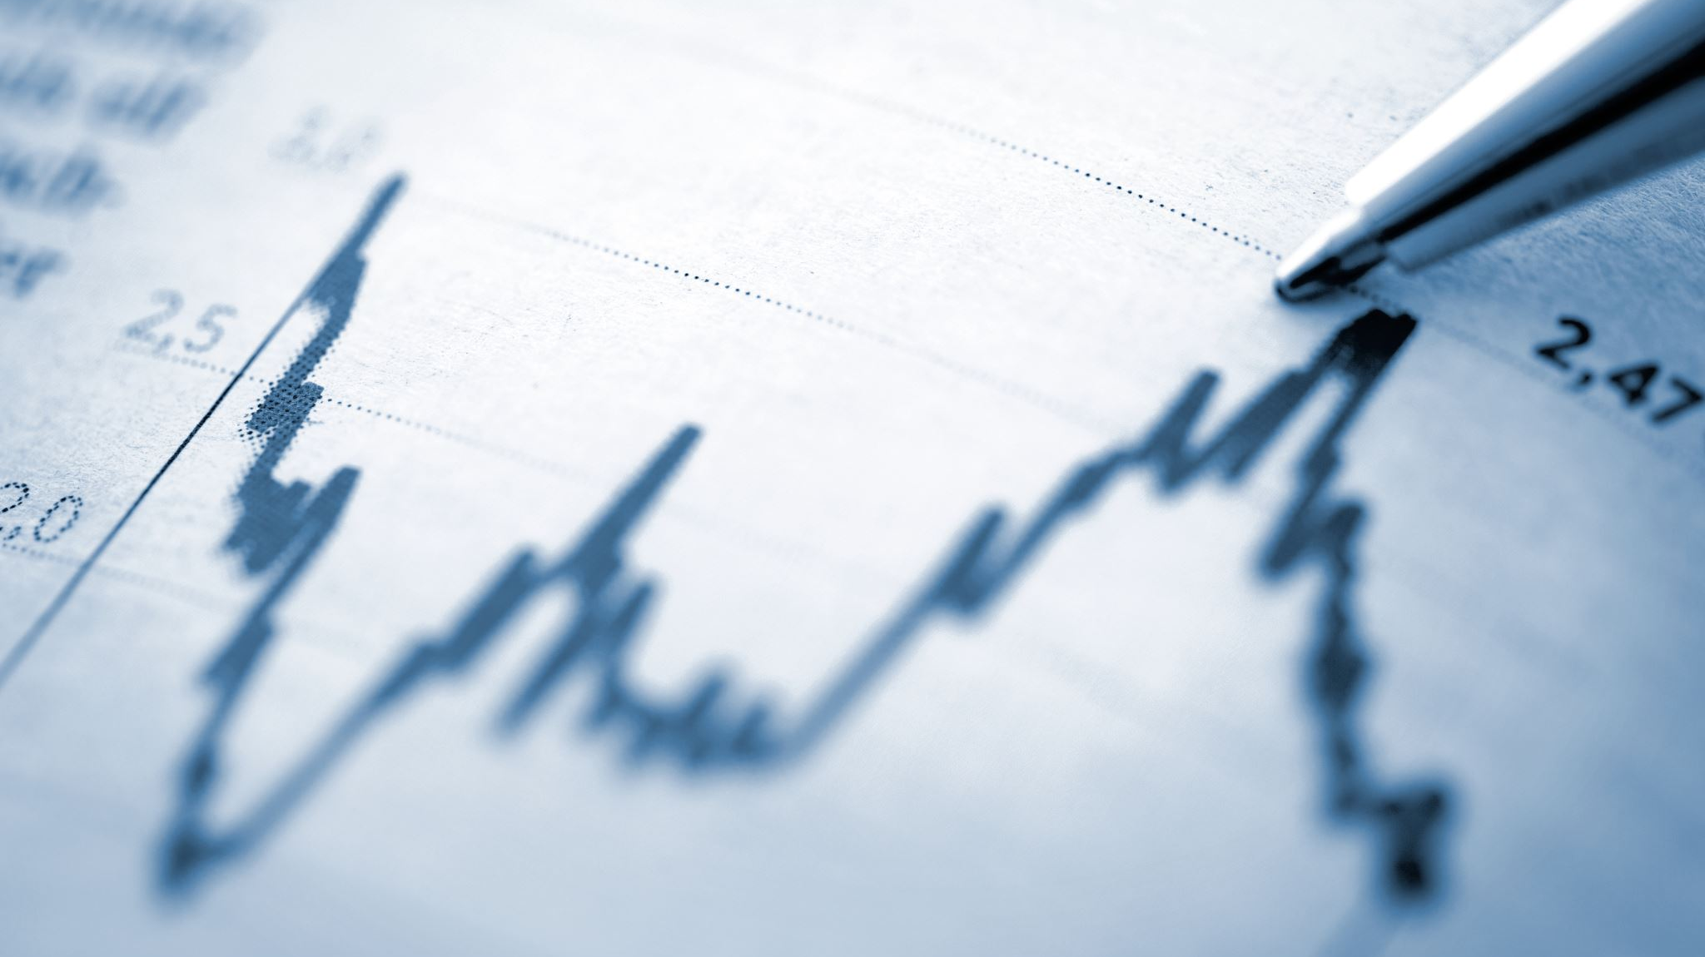
Moving Average Convergence Divergence

Slide 7
MACD indicator (function)
The MACD helps indicate direction, strength, and momentum during a trend in the market.

Slide 8

STOCHASTIC

Slide 9
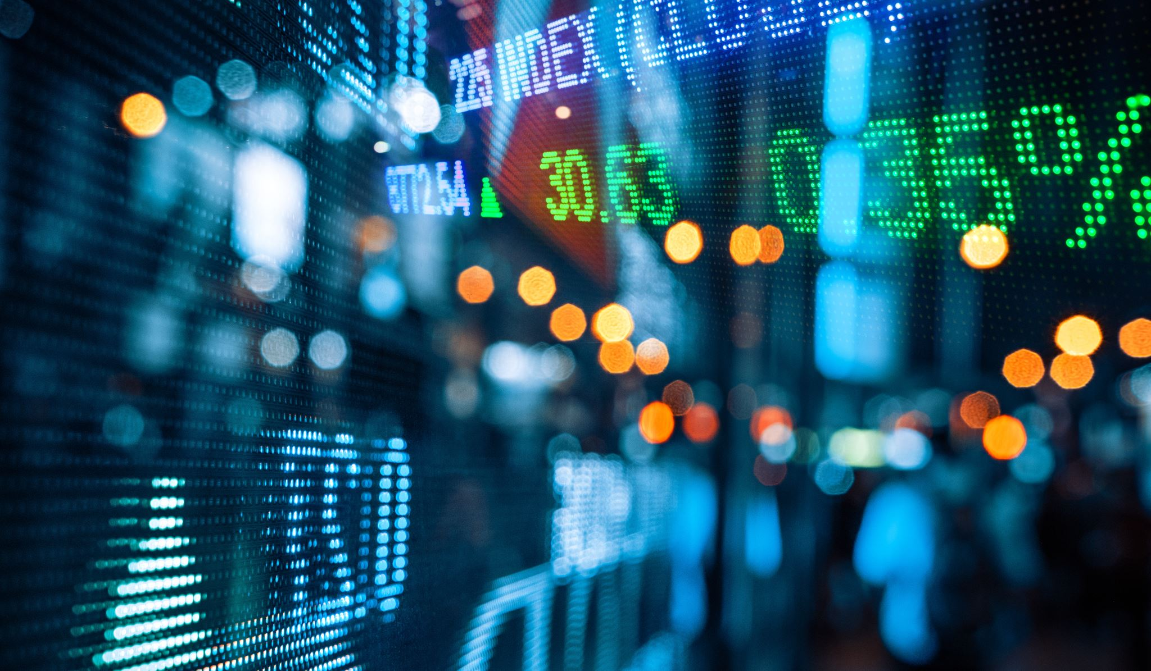
Relative Strength Index

Slide 10
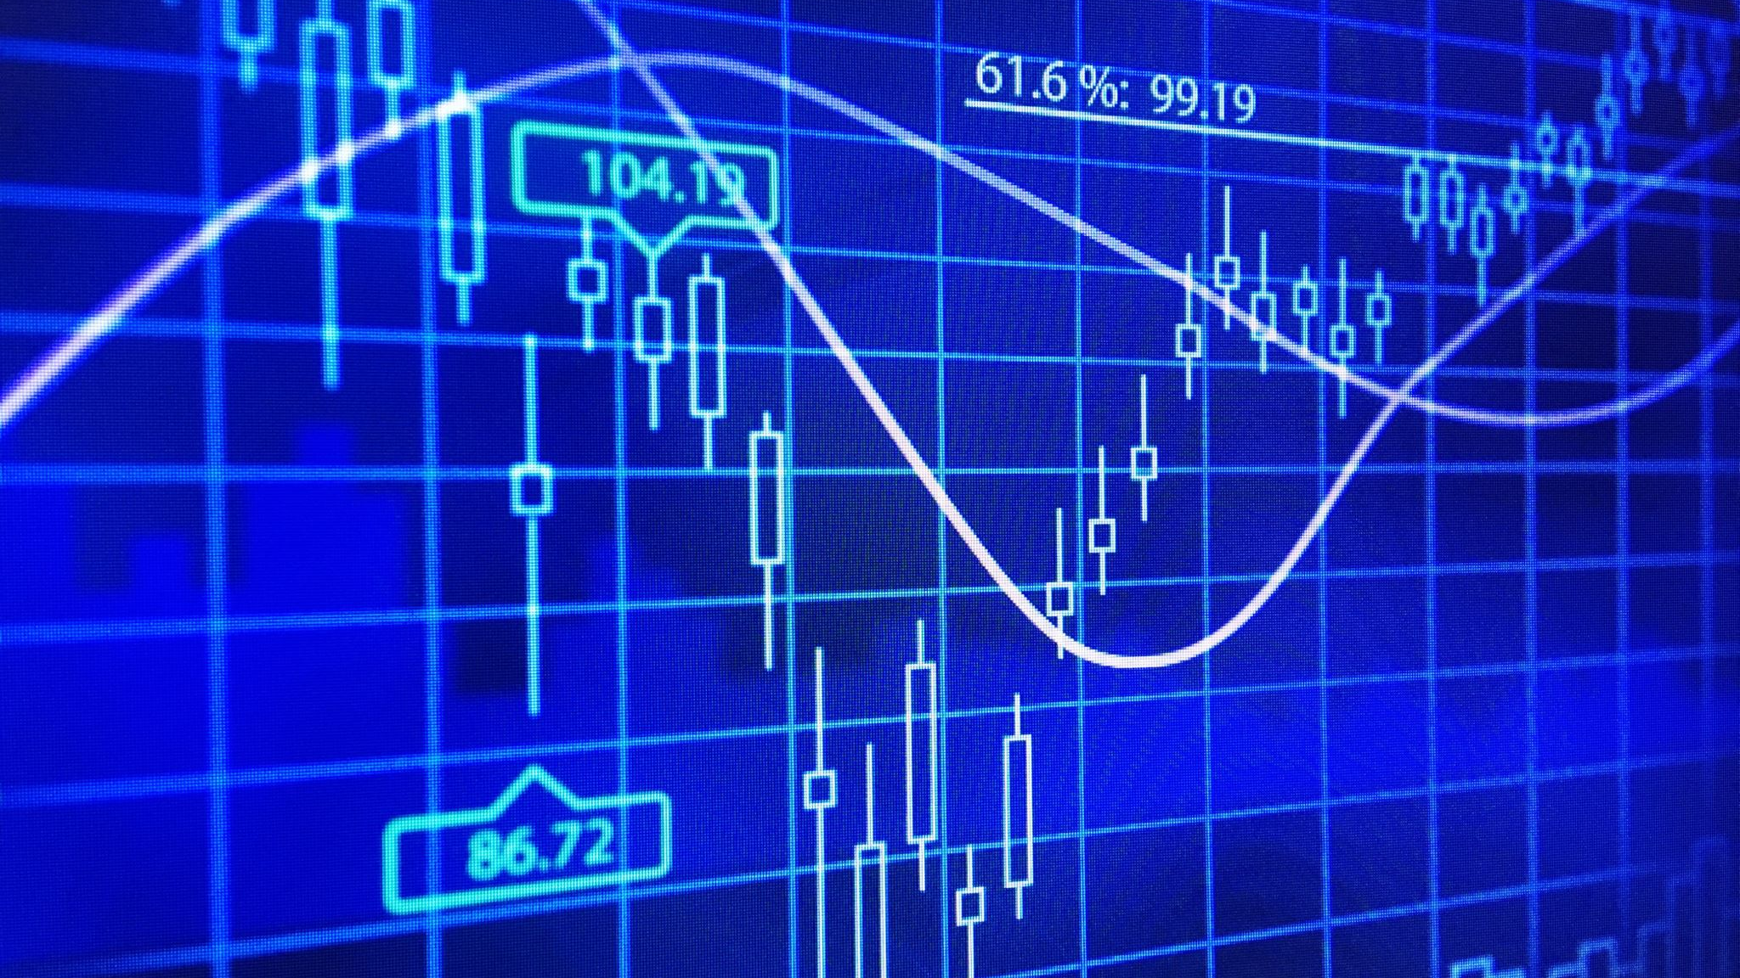
Bollinger Bands

Slide 11
On-Balance Volume

Slide 12

Top 3 Returns
Notes:
The top 3 indicators will be combined into the code and used

